Slide 1
Inventory management
Part 3
Notes:
This is the third part of a three-part series on inventory management. We will discuss two variants of the basic EOQ model to control inventory costs, namely, the economic production quantity (EPQ) and the quantity discount (QD) models.

Slide 2
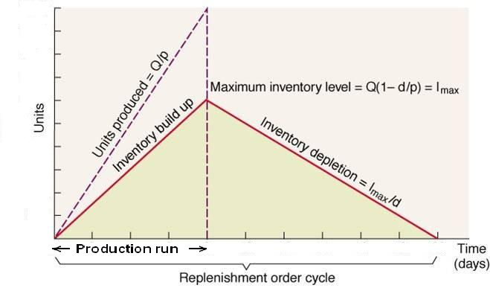
EPQ assumptions
Same as the EOQ except: inventory arrives in increments & is drawn down as it arrives
Notes:
EPQ operates under the same assumptions as the EOQ except that inventory arrives in increments instead of one single shipment. It is the model of choice when products are manufactured at a constant production rate of p units per day and consumed at a constant daily demand rate of d units per day. As a result, the maximum inventory level, Imax, is less than the order quantity by a factor of d/p. Production will go on until the maximum inventory level is reached then resume again when inventory runs out. This cycle of inventory pattern under EPQ is repeated through time as shown in the accompanying slide.

Slide 3
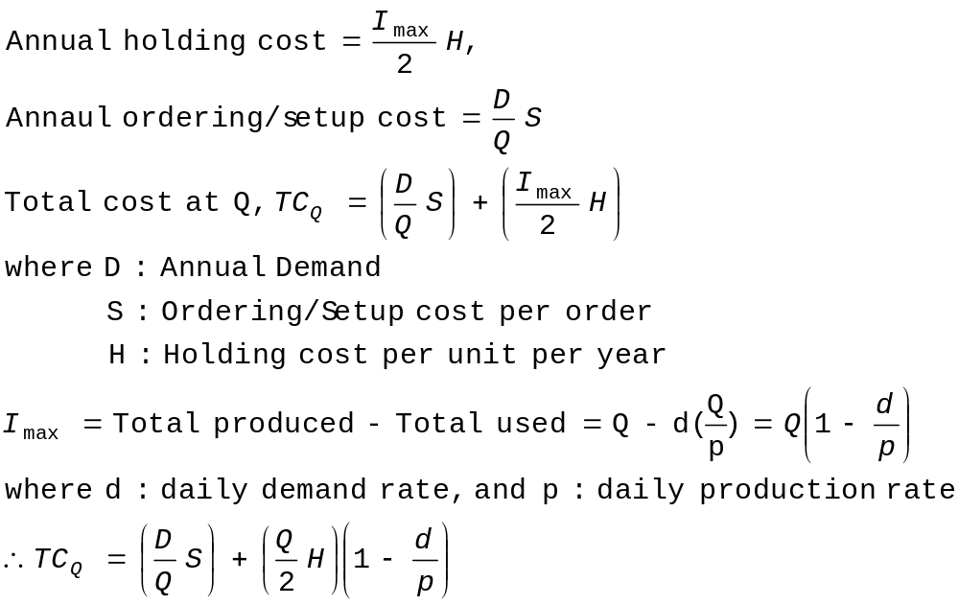
EPQ: Total cost equation
Notes:
The formula for the total annual inventory costs, TC_{Q} is shown in this slide. Annual setup cost is the product of the number of production runs per year (or annual demand, D, divided by production quantity, Q) and the setup cost per production run, S. Annual holding cost can be computed by multiplying the average of maximum inventory level, I_{max}/2, with the holding cost per unit per year, H. I_{max} in turn can be computed as Q(1-d/p) which is the total amount produced during the production run, Q, minus the total consumed during the same time period or dx(Q/p).

Slide 4
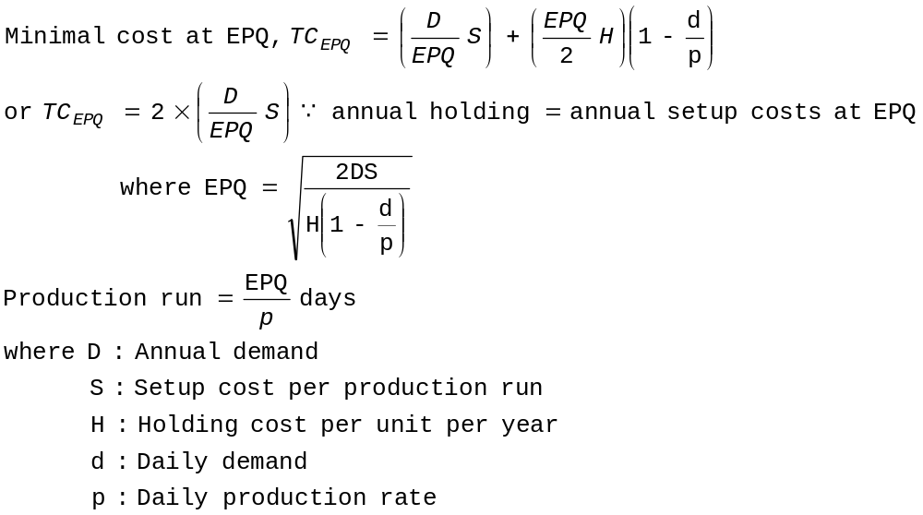
EPQ: Total cost equation continued
Notes:
The formulas for the minimal total annual inventory costs, TC_{EPQ}, and its associated production quantity, EPQ, are shown in this slide. Notice the added factor of (1-d/p) to the holding cost component accounts for the difference between the EOQ and EPQ models. The optimal length of production run can be computed by dividing EPQ by the daily production rate, P.

Slide 5
EPQ example
Given:
Annual demand = 15,000
Setup cost = $500 per production run
Holding cost = $50 per item per year
Number of working days per year = 240
Annual production rate = 25,000
What is the EPQ?
What is the total cost at EPQ?
What is the maximum inventory level?
What is the total number of production run in a year?
What is the length of production run?
What is the time between production?
What is the length of time with no production?
Notes:
We will use an example to demonstrate the workings of an EPQ model. You are given the annual product demand of 15,000, number of working days per year is 240, setup cost per production run is $500, holding cost is $50 per item per year, and a production rate of 25,000 units per year.

Slide 6
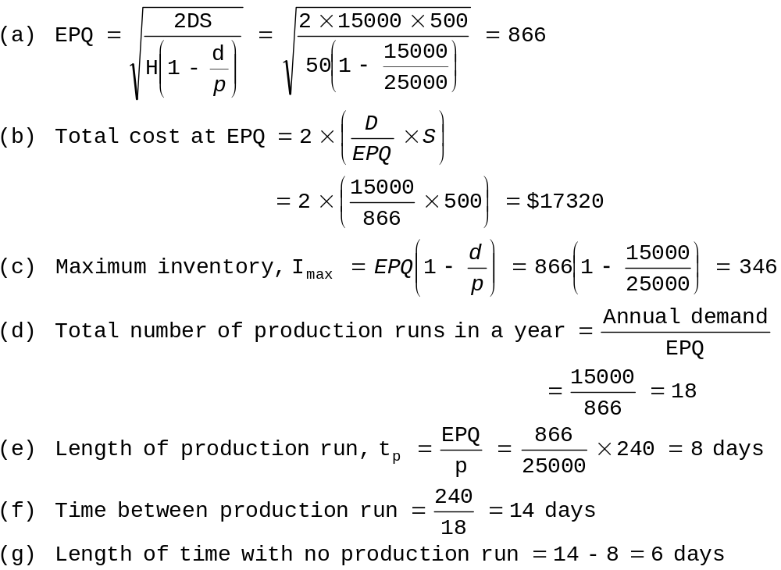
EPQ example continued
Notes:
EPQ can be computed by using the given formula in the previous slide and found to be 866 units. Once EPQ is known, its associated total inventory costs will be the twice the annual setup costs which is 2x15000x500/866, giving a total costs of $17320. Maximum inventory is found by multiplying EPQ by 1-d/p or 866x0.4=346 units. The total number of production runs in a year is the quotient of annual demand and EPQ which is 15000/866=18. The length of production run is found by dividing EPQ by daily production rate or 866x240/25000=8 days. The time between orders can be calculated by dividing the number of working days in a year, 240, by the total number of production run in a year, 18, and is found to be 14 days. This implies the length of time with no production is 14-8 or 6 days.

Slide 7
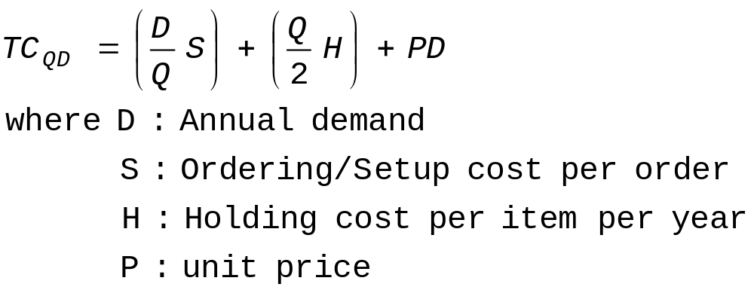
DQ assumptions
Same as the EOQ, except:
  Unit price depends upon the quantity ordered
Adjusted total cost equation:
Notes:
Discount quantity (DQ) model operates under the same assumptions as the EOQ model except that quantity discounts are considered. In this case, the total inventory costs consist not only the annual holding and setup costs but also the item costs as unit price no longer a constant irrespective of size of the order.

Slide 8
QD procedure
Calculate the EOQ at the lowest price
Determine whether the EOQ is feasible at that price (will the vendor sell that quantity at that price?)
If yes, stop –
  if no, bump the Q to the minimum level in that category
  Now it becomes feasible
Check the feasibility of EOQ at the next higher price
Continue until you identify a feasible EOQ
Notes:
There is a 8-step procedure to follow in applying the QD model to make sure that the larger quantity required to take advantage of the discounted price is indeed the most economical. The first step is to compute the EOQ at the lowest discounted price. If the r
esulting EOQ is feasible then we will order at the EOQ level. Otherwise, compute the EOQ at the next discounted price until a feasible EOQ is identified.

Slide 9
QD procedure continued
Calculate the total costs (including purchase price) for the all the feasible EOQ model
Calculate the total costs of buying at the minimum quantity allowed for each of the cheaper unit prices
Compare the total cost of each option & choose the lowest cost alternative
Notes:
The remaining steps involved total cost comparison. The total costs of the feasible EOQ model and the total costs of buying at the minimum quantity required to qualify for each level of discounts are computed. The lowest cost alternative will be chosen as the recommended order policy.

Slide 10
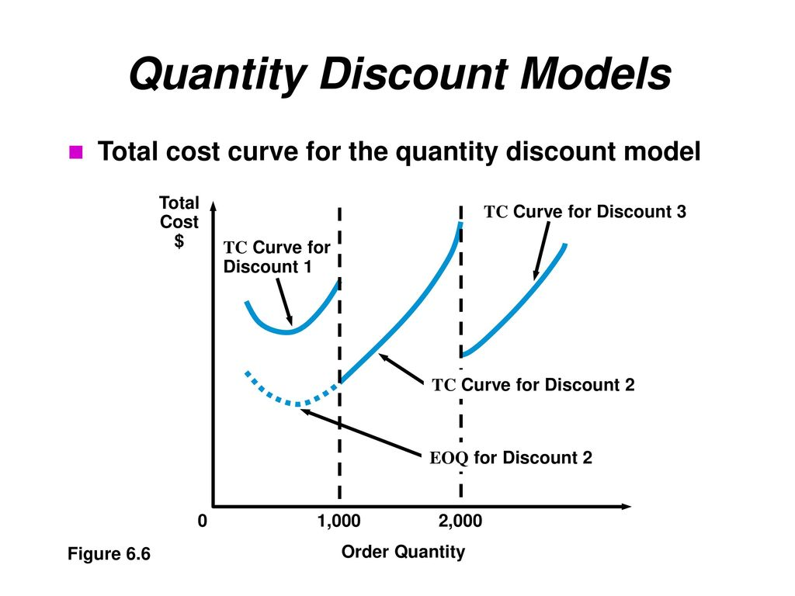

Slide 11
QD example #1
Given:
annual demand = 100 units
Ordering cost = $45 per order
Holding cost per year = 20% of item cost
Quantity discounts:
Order quantity | Cost per item
50 or less | $18
51 to 59 | $16
60 or more | $12
Notes:
We will conclude by using three examples to illustrate the workings of a QD model. You are given the annual demand of 100 units, ordering cost of $45 per order, and holding cost per year is 20% of unit item cost. The discount structure for example one is as given.

Slide 12
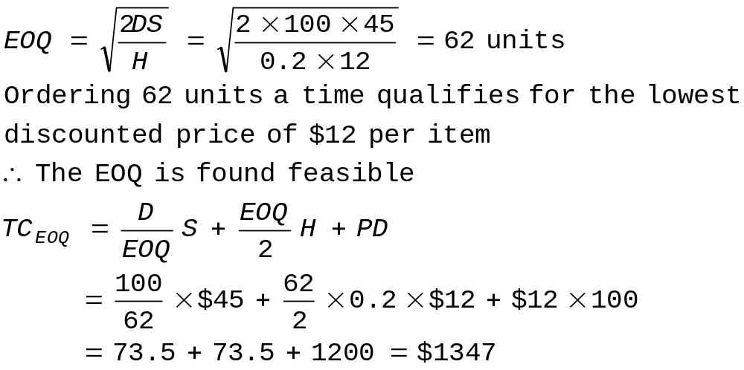
QD example #1 continued
The lowest cost per item is $12 if ordered 60 units or more
→Order at 62 units at a time is the recommended policy
Notes:
Following the 8-step procedure discussed earlier, the first step is to compute EOQ using the lowest item cost available. In this example, the lowest item cost is $12 when an order of 60 or more is placed. The resulting EOQ is found to be 62 units which is feasible. This implies the ordering policy is to order 62 units at a time and take advantage of a discounted price of $12 per item. The associated total cost is $1347 which consists of $73.5 of annual holding cost, $73.5 of annual ordering cost and $1200 of item cost.

Slide 13
QD example #2
Given:
annual demand = 100 units
Ordering cost = $45 per order
Holding cost per year = 20% of item cost
Quantity discounts:
Order quantity | Cost per item
50 or less | $18
51 to 99 | $16
100 or more | $12
Notes:
The second example uses a slightly different discount structure as shown in red in the given table.

Slide 14
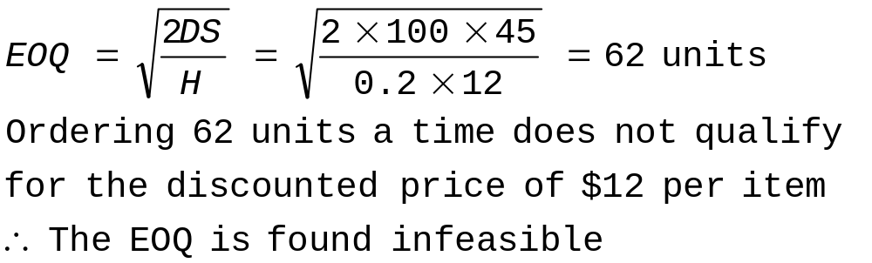
QD example #2 continued
The lowest cost per item is $12 if ordered 100 units or more
Notes:
The first step is to compute EOQ using the lowest item cost available. In this example, the lowest item cost is $12 when an order of 100 or more is placed. The resulting EOQ is found to be 62 units which is infeasible.

Slide 15
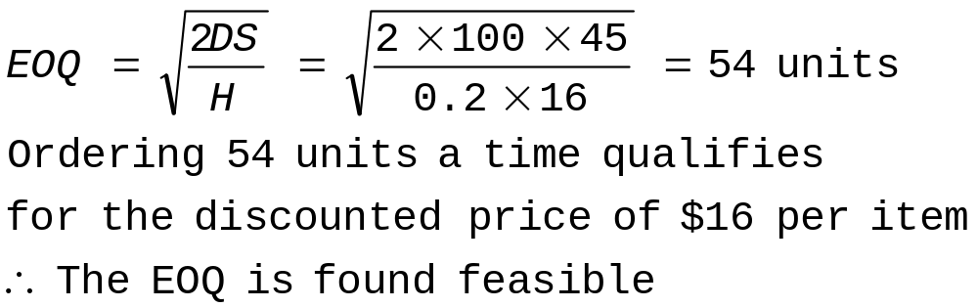
QD example #2 continued
The next lowest cost per item is $16 if ordered between 51 to 99 units
Notes:
The next step is to compute EOQ using the next lowest item cost available. In this example, the next lowest item cost is $16 when ordered between 51 to 99 units. The resulting EOQ is found to be 54 units which is feasible.

Slide 16
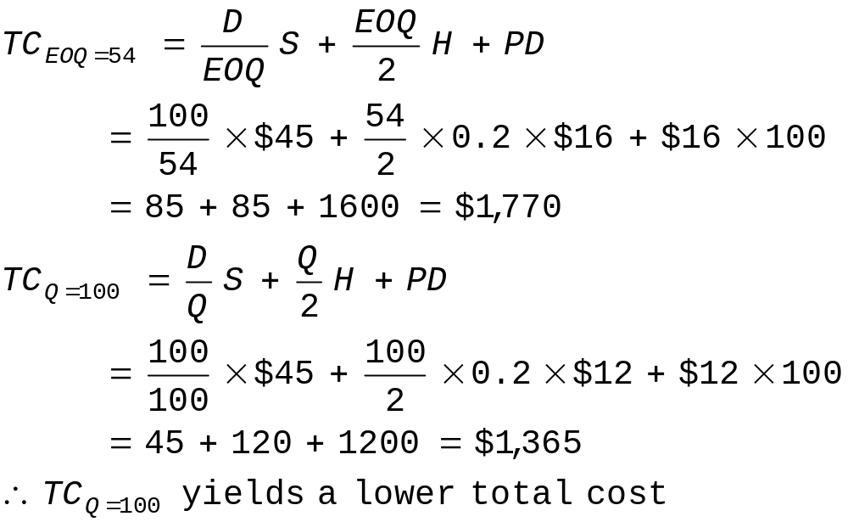
QD example #2 continued
Cost comparisons:
→Order at 100 units at a time is the recommended policy
Notes:
The remaining steps involved comparing the total cost of ordering at an EOQ of 54 units and the minimum quantity that qualifies for the lowest item cost which is 100 units at $12 per item. It is found that ordering 100 units at a time yields a lower total cost, which is $1365 as opposed to $1770 when ordering at the EOQ of 54 units.

Slide 17
QD example #3
Given:
annual demand = 100 units
Ordering cost = $45 per order
Holding cost per year = 20% of item cost
Quantity discounts:
Order quantity | Cost per item
55 or less | $18
56 to 99 | $16
100 or more | $12
Notes:
The final example uses yet another discount structure as shown in red in the given table.

Slide 18
QD example #3 continued
The lowest cost per item is $12 if ordered 100 units or more
Notes:
The first step is to compute EOQ using the lowest item cost available. In this example, the lowest item cost is $12 when an order of 100 or more is placed. The resulting EOQ is found to be 62 units which is infeasible.

Slide 19

QD example #3 continued
The next lowest cost per item is $16 if ordered between 56 to 99 units
Notes:
The next step is to compute EOQ using the next lowest item cost available. In this example, the next lowest item cost is $16 when ordered between 56 to 99 units. The resulting EOQ is found to be 54 units which is infeasible.

Slide 20
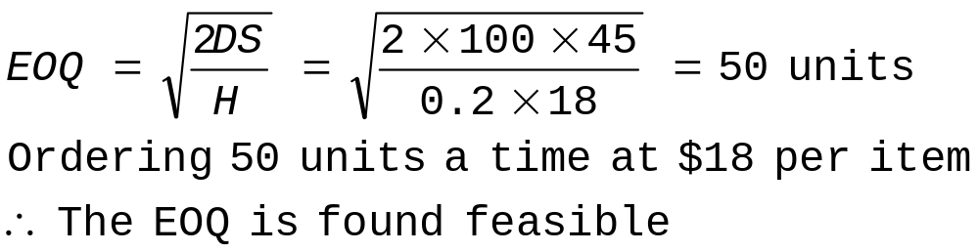
QD example #3 continued
The remaining cost per item is $18 if ordered less than 56 units
Notes:
The next step is to compute EOQ using the next and final item cost available. In this case, the item cost is $18 giving an EOQ of 50 units which is feasible.

Slide 21
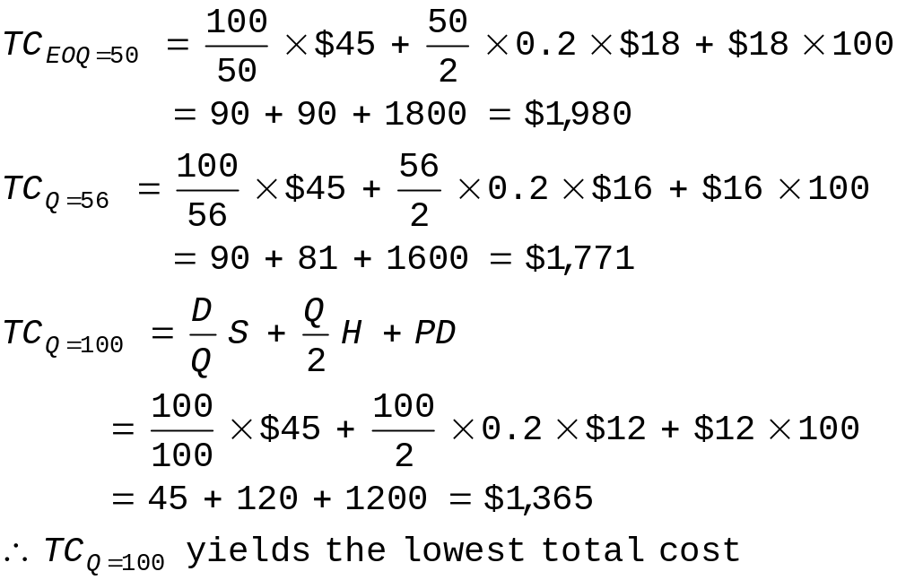
QD example #3 continued
Cost comparisons:
→Order at 100 units at a time is the recommended policy
Notes:
The remaining steps involved comparing the total cost of ordering at an EOQ of 50 units and the minimum quantity that qualifies for each discounted item cost which are 56 units at $16 per item and 100 units at $12 per item. It is found that ordering 100 units at a time yields a lower total cost, which is $1365 as opposed to $1771 when ordering at 56 units and $1980 when ordering at 50 units.

